Slide 1

TEEGALA KRISHNA REDDY ENGINEERING COLLEGE
(Approved By AICTE , Affiliated To JNTUH, Accredited By NBA And NAAC)
Department of Computer Science & Engineering
HEAD OF THE DEPARTMENT PROJECT CO-ORDINATOR
Dr. CH. V. PHANI KRISHNA Mrs.Ch.Divya
Professor Assistant Professor

Slide 2
Financial Fraud Detection Using Value At Risk With Machine Learning
SUPERVISOR
Y.Guravaiah
(Assistant Professor)
NAME OF THE STUDENTS
M.Pranavi (23R91A05H6)
K.Sri Nithya (23R91A05G7)
K.Naresh (23R91A05F3)
M.Janaki Ram (24R95A0519)

Slide 3
CONTENTS
ABSTRACT
EXISTING SYSTEM
PROPOSED SYSTEM
SYSTEM REQUIREMENTS
SYSTEM ARCHITECTURE
REFERENCES

Slide 4
ABSTRACT
Financial fraud is a major challenge in banks and digital payment systems due to the rapid growth of online transactions. Fraudulent activities cause financial losses and reduce customer trust. This project presents a Financial Fraud Detection System using Value-at-Risk (VaR) with Machine Learning. The VaR method estimates the financial risk of each transaction, while machine learning algorithms classify transactions as genuine or fraudulent. Data preprocessing and feature selection improve prediction accuracy. The proposed system reduces false alarms, detects suspicious activities in real time, and supports better risk management. It provides a secure, scalable, and efficient solution for protecting financial transactions..

Slide 5
EXISTING SYSTEM
Existing fraud detection systems mainly rely on rule-based techniques, manual monitoring, and historical transaction analysis. These systems use predefined rules to identify suspicious transactions but are unable to detect new and evolving fraud patterns effectively.
Drawbacks or Limitations:
➤ Depends on fixed rules and manual monitoring.
➤ Cannot detect new or unknown fraud patterns.
➤ High false positive and false negative rates.
➤ Slow processing for large volumes of transactions.
➤ Less accurate for real-time fraud detection.

Slide 6
PROPOSED SYSTEM
To provide an intelligent and accurate fraud detection solution. VaR estimates the financial risk of each transaction, while machine learning models analyze transaction patterns and classify them as genuine or fraudulent. By using data preprocessing and feature selection, the system improves detection accuracy, reduces false alarms, and enables real-time monitoring of financial transactions.
ADVANTAGES
➤ Detects fraudulent transactions in real time.
➤ Improves accuracy using machine learning algorithms.
➤ Reduces false alarms and financial losses.
➤ Enhances financial risk management.
➤ Increases customer trust and transaction security.

Slide 7
SYSTEM REQUIREMENTS
Hardware Requirements:
Processor: Intel Core i3 / AMD Ryzen 3 or above
RAM: 4 GB minimum (8 GB recommended)
Hard Disk: 20 GB free space
Monitor: 1366 × 768 resolution or higher
Internet Connection: Required for downloading datasets and updates
Software Requirements:
Operating System: Windows 10/11 or Linux
Programming Language: Python 3.10+
IDE: PyCharm / Visual Studio Code
Database: MySQL
Machine Learning Libraries:
Pandas
NumPy
Scikit-learn
Matplotlib

Slide 8
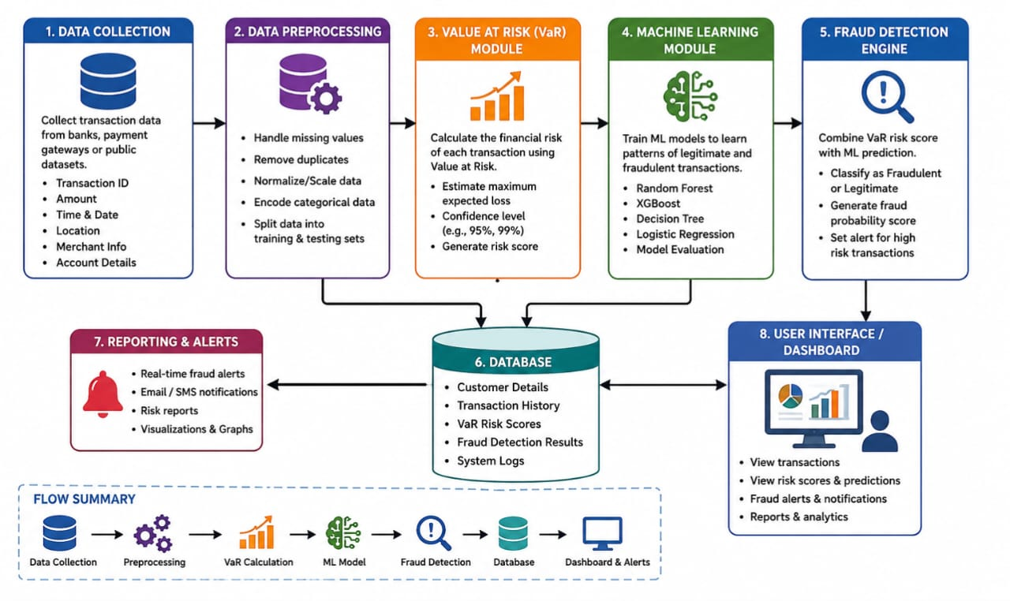
SYSTEM ARCHITECTURE

Slide 9
REFERENCES
L. Breiman, "Random Forests," Machine Learning, vol. 45, no. 1, pp. 5–32, 2001.
T. Chen and C. Guestrin, "XGBoost: A Scalable Tree Boosting System," Proceedings of the 22nd ACM SIGKDD International Conference on Knowledge Discovery and Data Mining, 2016.
S. Russell and P. Norvig, Artificial Intelligence: A Modern Approach, 4th Edition, Pearson, 2020.
I. Goodfellow, Y. Bengio, and A. Courville, Deep Learning, MIT Press, 2016.
Kaggle, Credit Card Fraud Detection Dataset.
IEEE Xplore Digital Library – Research papers on Financial Fraud Detection and Machine Learning.

Slide 10


